Slide 1
Predicting Loan Default Risk with Machine Learning: Home Credit
—Athena Zhao

Slide 2
Problem and Datasets
What are trying to predict?
-Each observation → one loan application
-Target= whether the applicant defaults
Target=1:default, Target=0: no default
-Evaluation metric: ROC-AUC
Rather than predicting a yes/no outcome, the model outputs a probability of default for every applicant.

Slide 3
Data Sources
The key challenge here is that every csv file has different structure.
-application.csv–one row per applicant
SK_ID_CURR | income | age | education | credit amount | TARGET
----------------------------------------------------------------
100001 | ... | ... | ... | ... | 0
100002 | ... | ... | ... | ... | 1
100003 | ... | ... | ... | ... | 0
bureau.csv–multiple previous credits per applicant
installments–many payment records per previous credit
monthly balance tables—represted observations over time
—> merge once or twice based on the ID for each applicant
bureau.csv
there may be several credit records for one user.
it may be 100001–4 rows.
so we need to merge them first through:
number of previous credits
average DAYS_CREDIT
maximum overdue
total credit amount
average debt

Slide 4
Model Selection
Logistic regression: 0.632
Random Forest: 0.737
HistGradientBoosting: 0.759
XGBoost:0.761
→ finally i chose HistGradientBoosting
First, we set the baseline with Application data:
age, log-income..
Then we add the other data sets by HistGrandientBoosting.
Pipeline: Median imputation, HistGradientBoostingClassifier, Five Fold Cross Validation

Slide 5
More about Gradient Boosting
We are using: learning_rate:0.05, max_iteration:200, max_leaf_nodes=31, random_state=42
learning rate:controls how much each new tree contributes to the overall model. Smaller learning rate means making smaller corrections at each step.
max_iter: controls the maximum number of boosting iterations, which is the maximum number of trees.
There will be a tradeoff between learning rate and max iteration. Taking a smaller step each time definitely gives a larger number of steps.
max_leaf_nodes: controls the maximum number of leaves in each individual decision tree. This is about the complexity of each tree. Increasing the parameter gives each tree more capacity to capture complicated patterns, but it can also increase the risk of overfitting.
random_state: controls the randomness used by the algorithm so that your results can be reproduced.

Slide 6
Hyperparameter Tuning: Grid Search
"model__learning_rate": [0.03, 0.05, 0.1],
"model__max_iter": [100, 200, 300],
"model__max_leaf_nodes": [15, 31, 63]
27 combinations * 5-fold CV=135 fits
Best parameters:
{'model__learning_rate': 0.03, 'model__max_iter': 300, 'model__max_leaf_nodes': 63}
Best CV ROC-AUC:
0.7792178076161225

Slide 7
Model Performance:Using Histgradientboosting
Set Mean_ROC_AUC
0 Application 0.756787
1 + Bureau 0.760437
2 + Bureau Status 0.761416
3 + Previous Application 0.763671
4 + Installments 0.769354
5 + Bureau Balance 0.769635
6 + POS_CASH 0.775390
7 + Credit Card Balance 0.779217

Slide 8
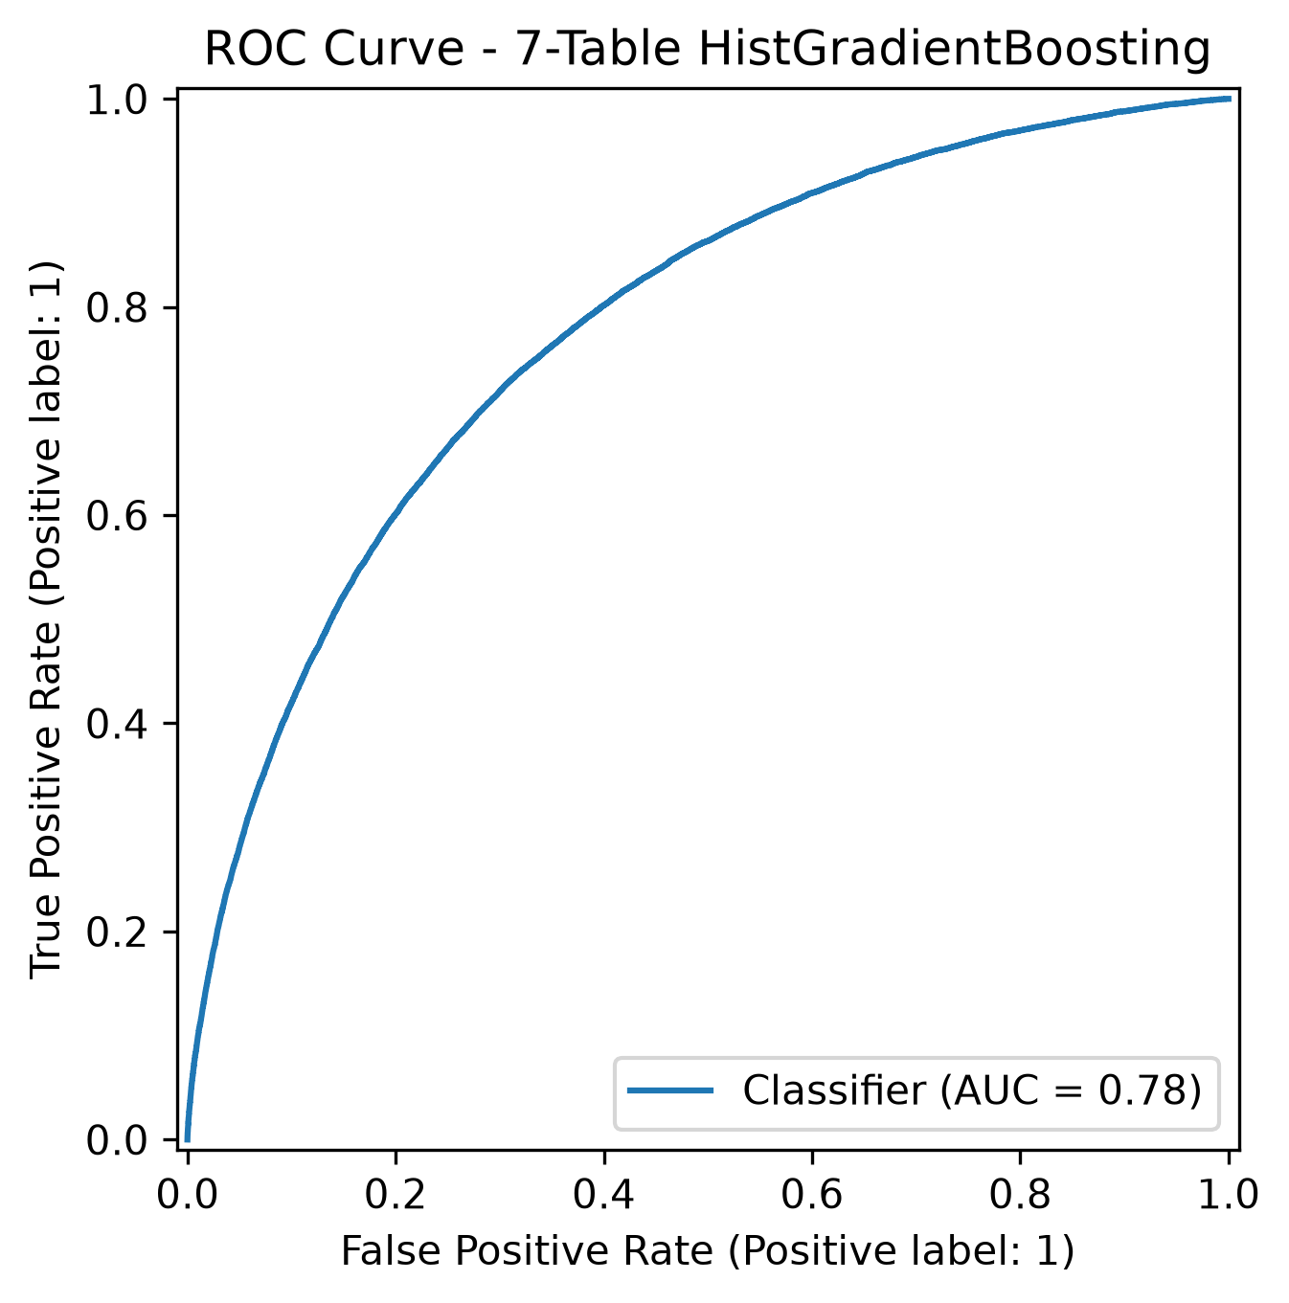
Results and Graphs
ROC Curve:
X-axis: False Positive Rate= % of good borrowers incorrectly marked as high-risk
Y-axis: True Positive Rate=% of actual defaulters caught
when AUC =0.5, this means a random guess, which is the diagonal line.

Slide 9
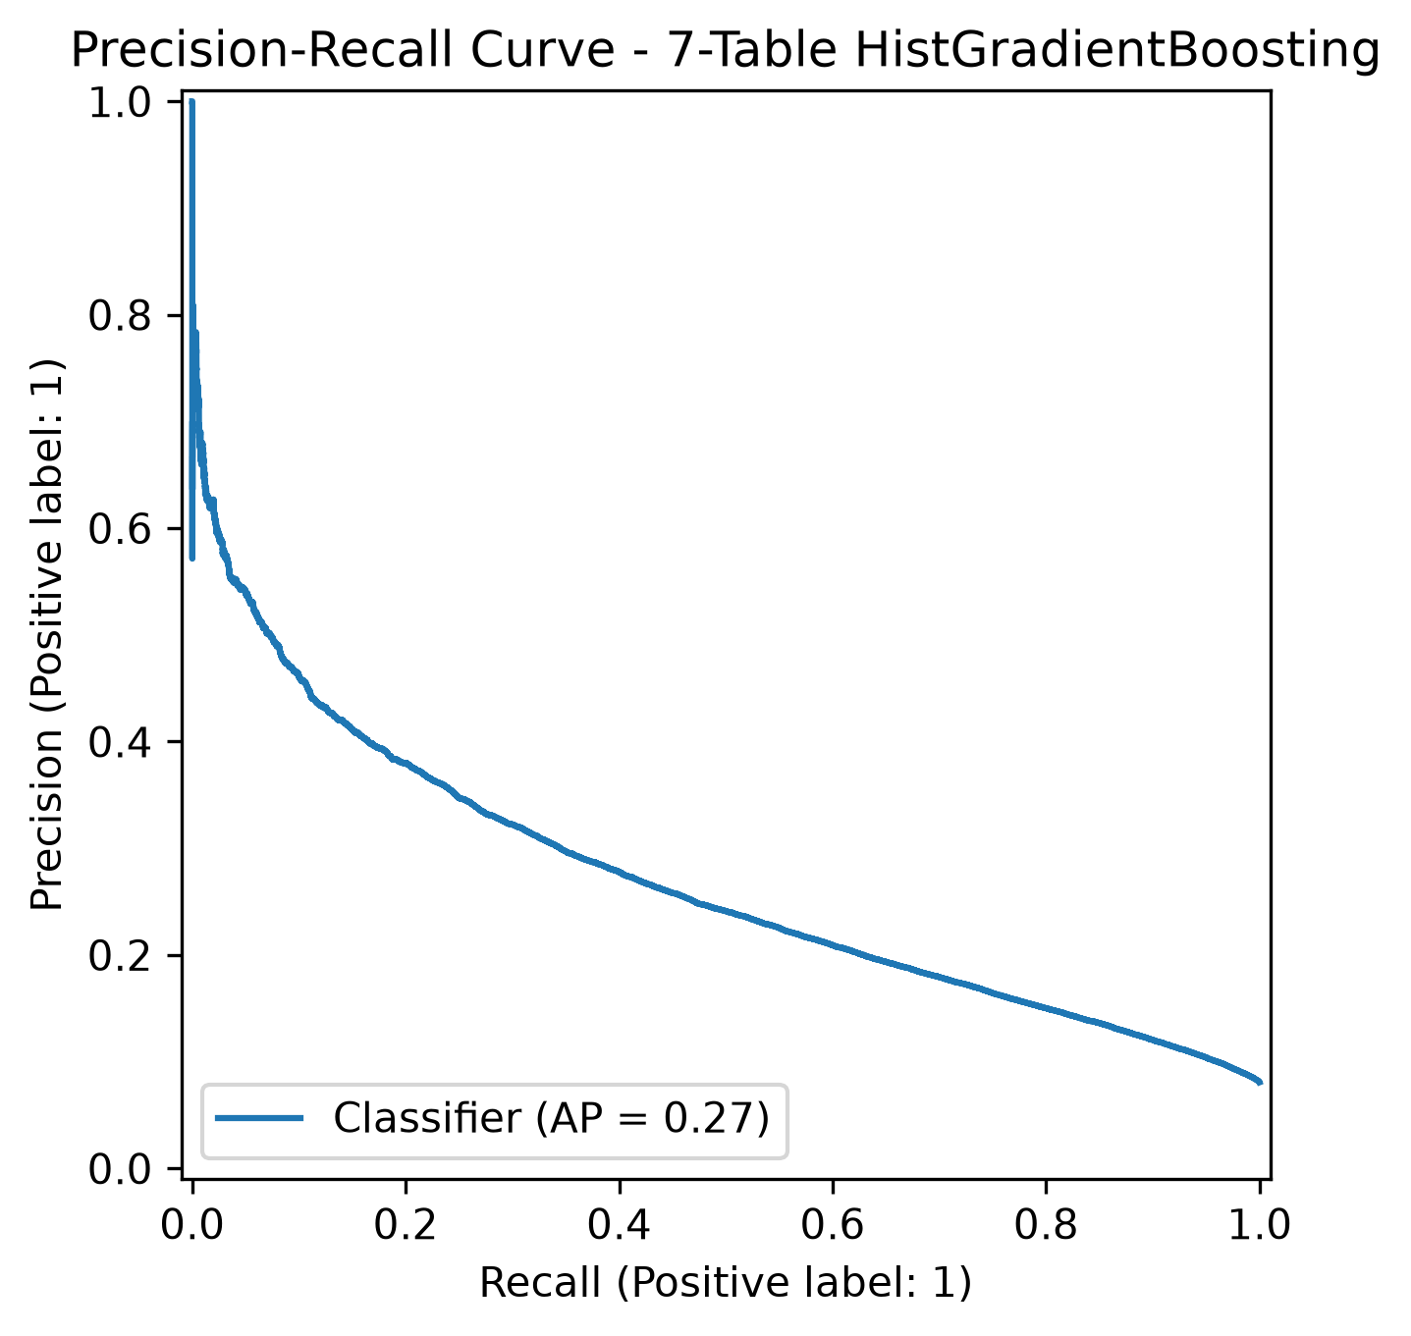
Results and Graphs
X-axis: Recall, sensitivity=TP/TP+FN, % of real defaulters the model catch
Y-axis: precision=TP/TP+FP, among all the high risk flagged people, what fraction actually default.
AP=0.27: when we label some high risk borrowers, most of them are still good borrowers. However, this is good because for Home Credit, we prefer getting good borrowers wrongly defined as high risk rather than treating high risk people as good ones.

Slide 10
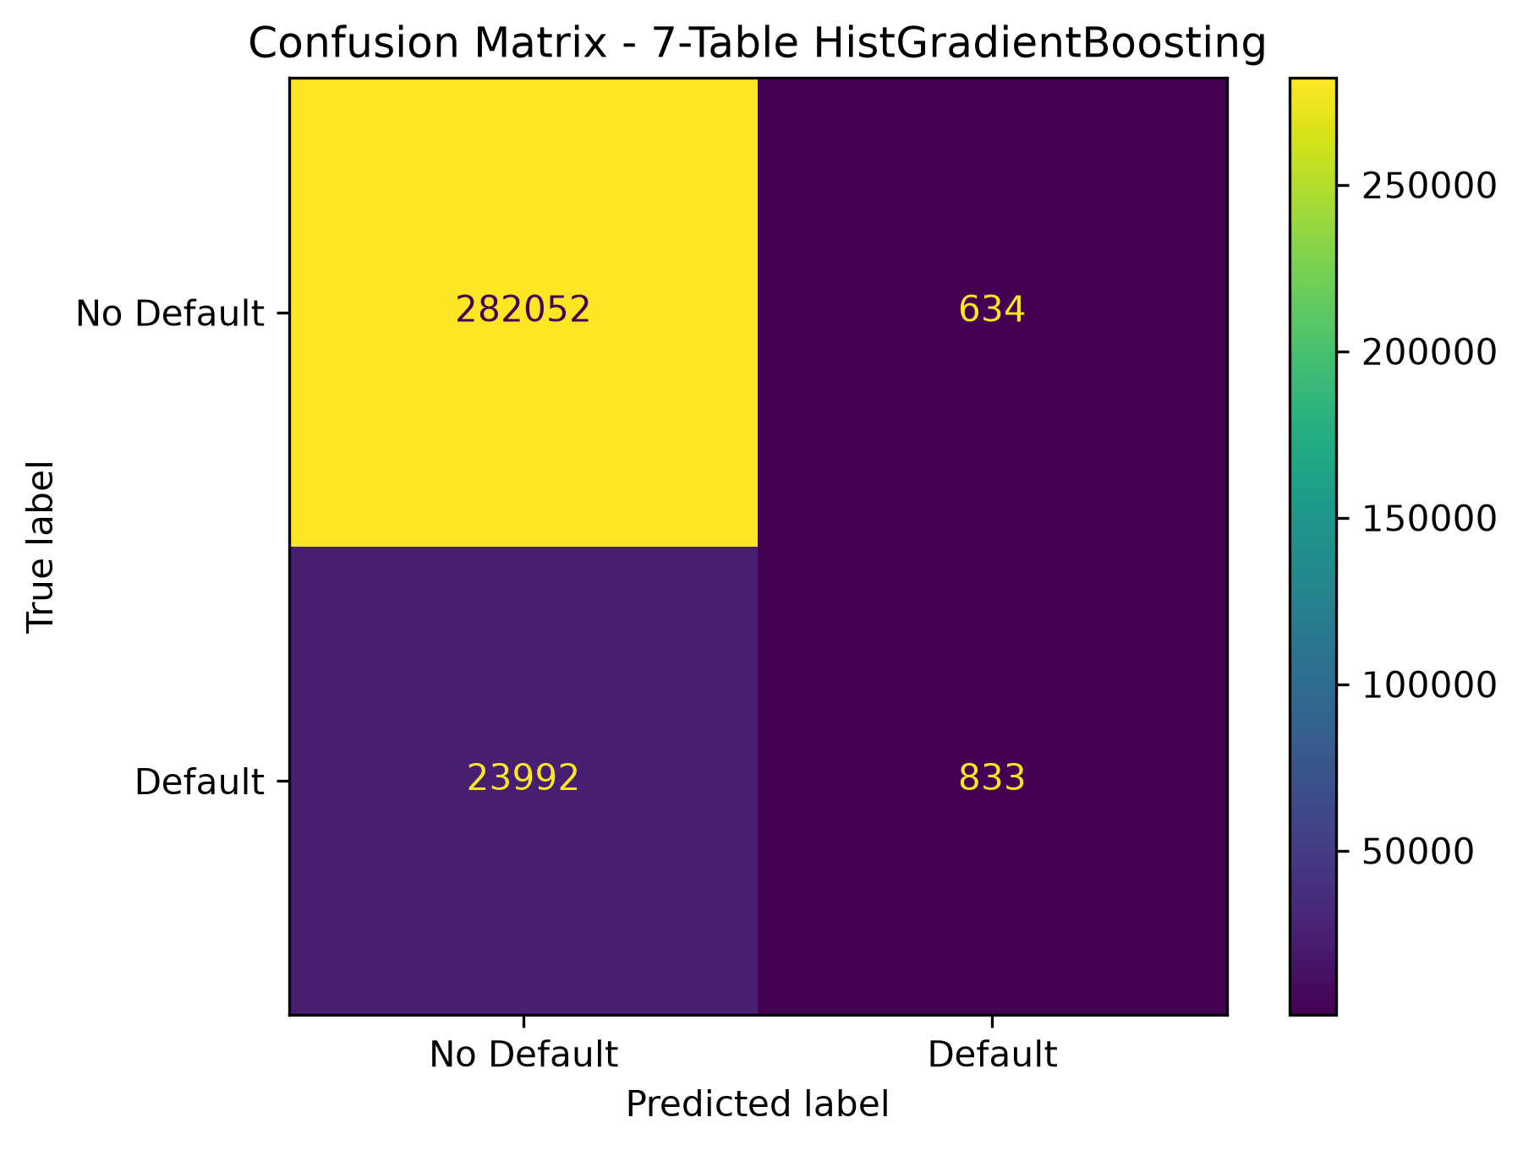
Results and Graphs

Slide 11
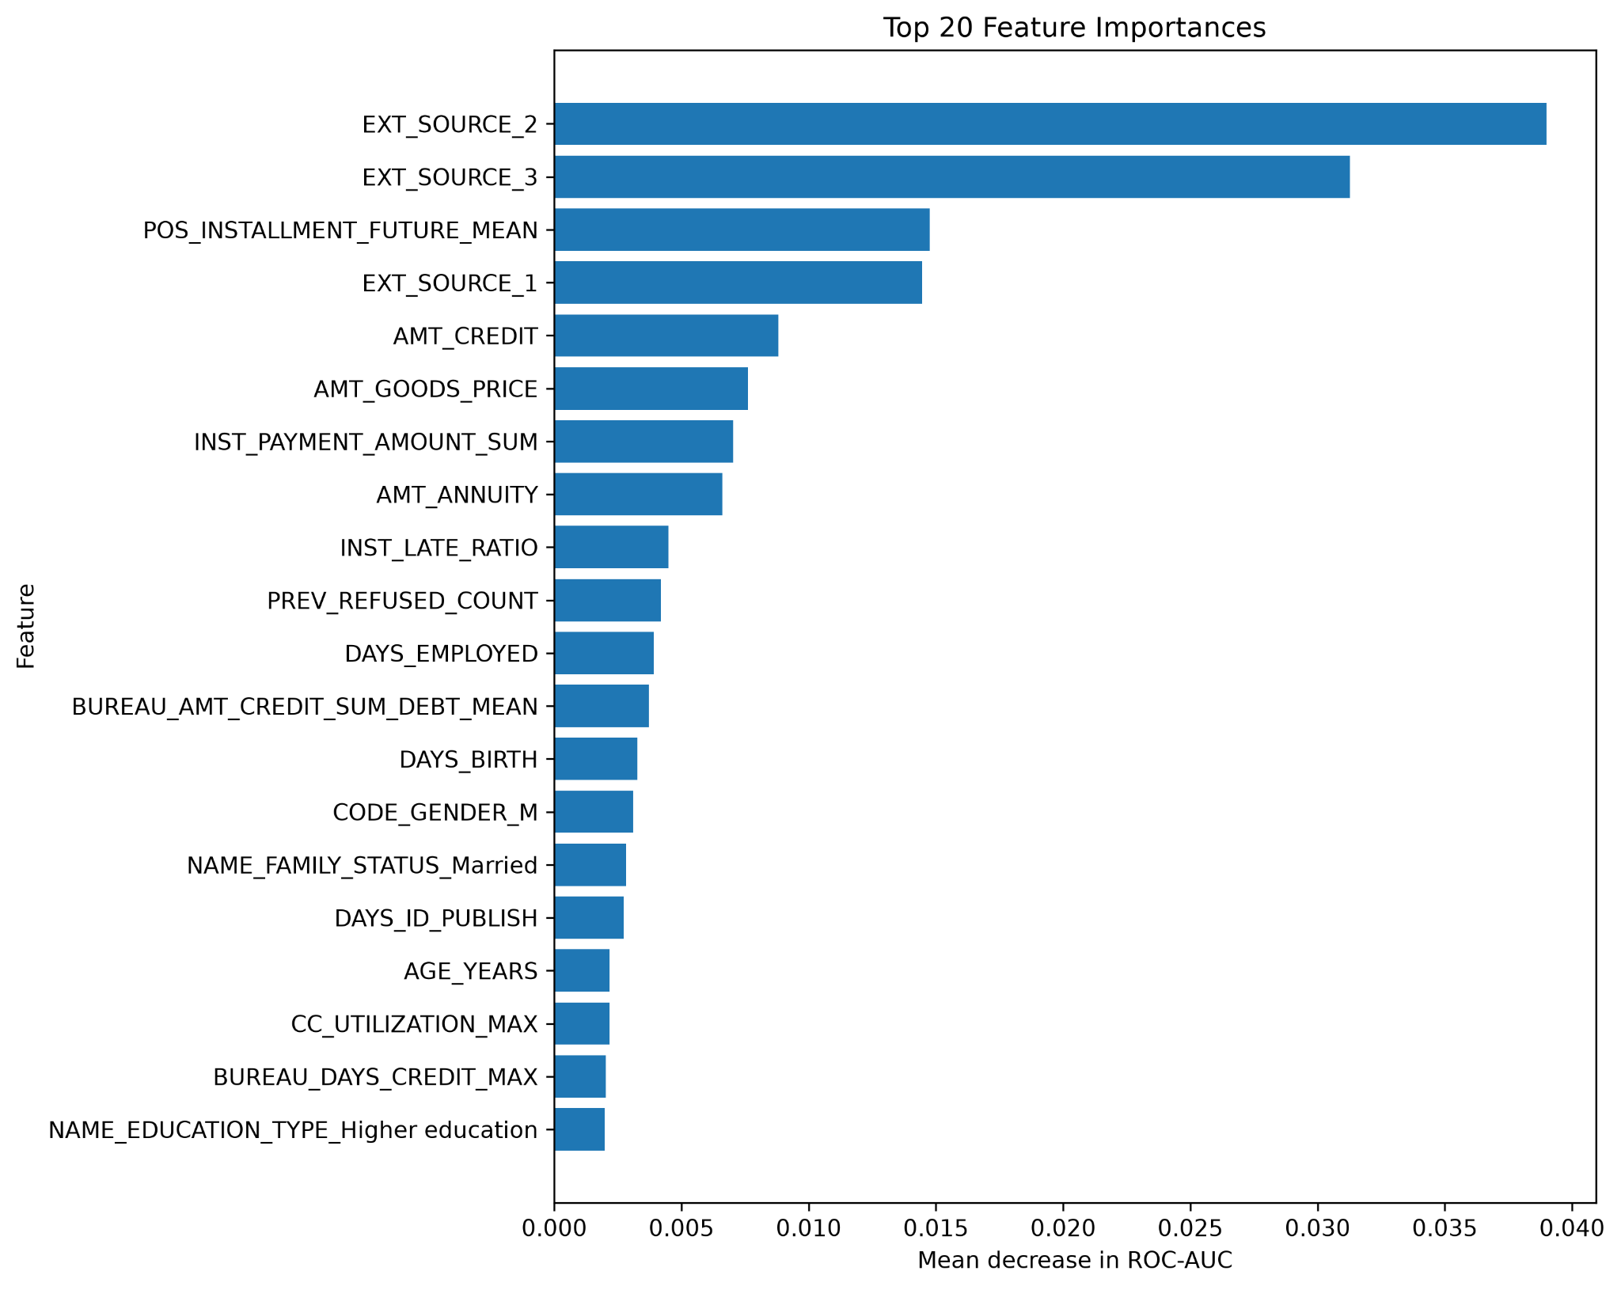
Results and Graphs

Slide 12
Final Test with testing data:Out-of-sample
application_test.csv
→ application level features (age, log income)
→ merge historical credit information
→ applicant level information matrix
→align columns with training data
→ final tuned model
→ Predicted default probability
SK_ID_CURR TARGET
0 100001 0.034455
1 100005 0.136772
2 100013 0.023409
3 100028 0.030546
4 100038 0.104479

